Slide 1
ASIC Implementation of Motion Estimator in 32/28nm CMOS
Andrew Miller
Ali Attaran
Bobby
ENGR 852 Project
Professor Dr. Mahmoodi
Dec 2016

Slide 2
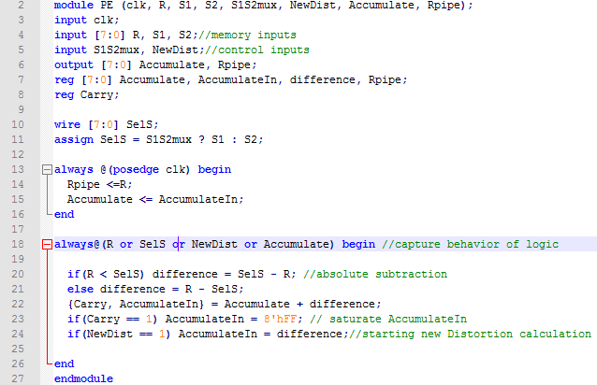

Implementation – Changes to Source

Slide 3

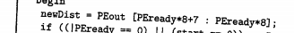
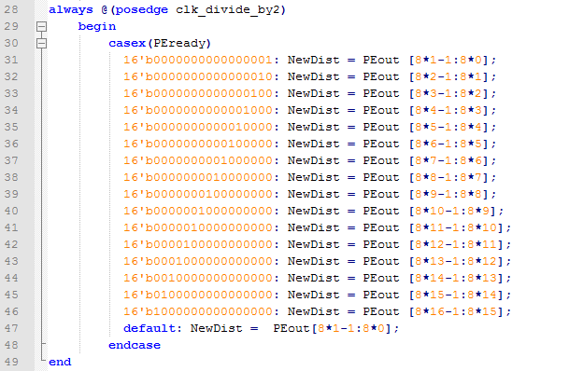
Implementation – Changes to Source

Slide 4
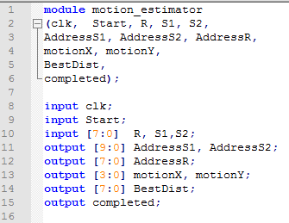
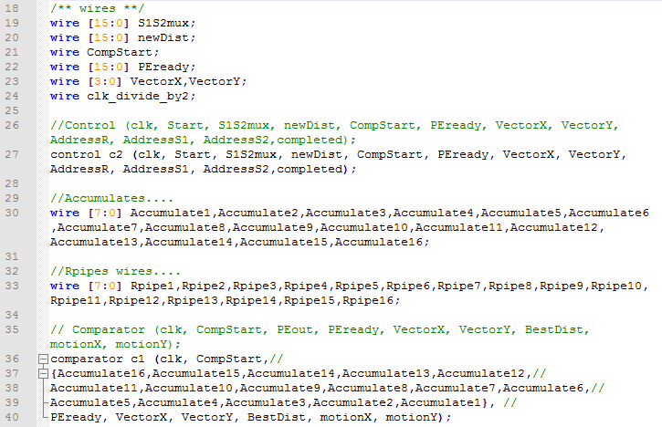
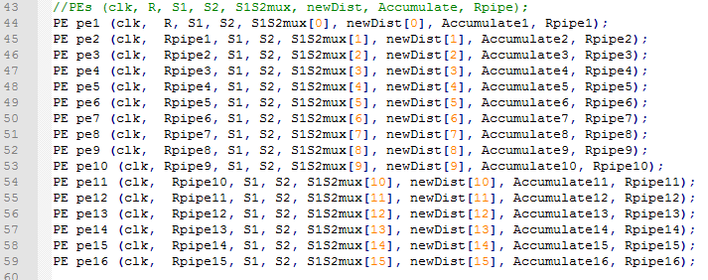
Implementation – Top Level

Slide 5
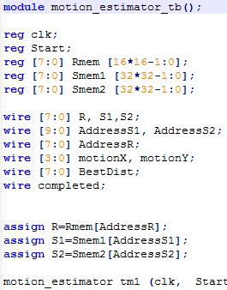
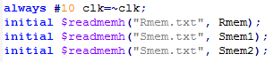
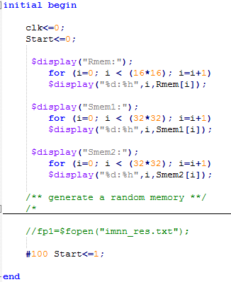
TEST BENCH AND SIMULATION

Slide 6
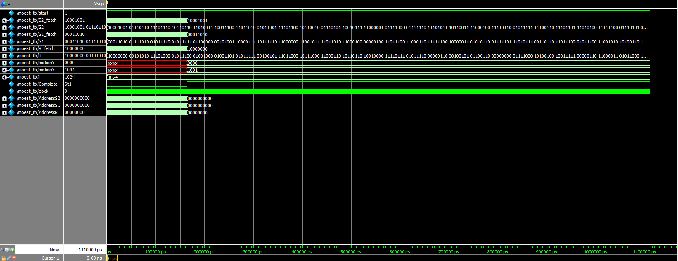
TEST BENCH AND SIMULATION
Top module is simulated at the specified speed to make sure it works at run time.
at 3.84ns period

Slide 7
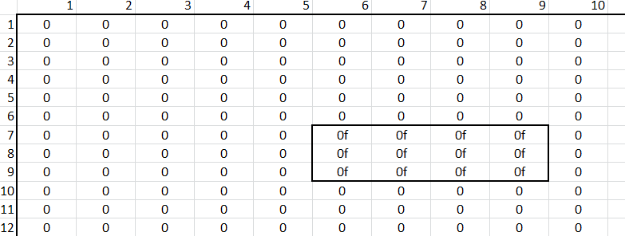
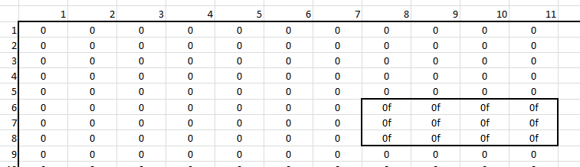
Simulation Validation
Rmem
“Dark” pixels representing an object being tracked
Smem
Motion (2,1)

Slide 8
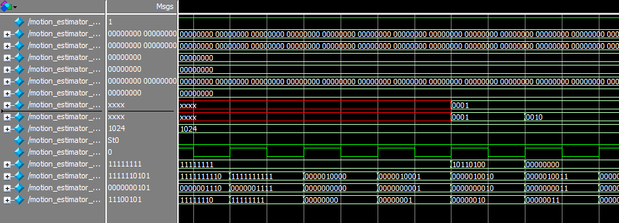
Simulation Validation
Motion Y detects correctly
Motion X detects correctly

Slide 9
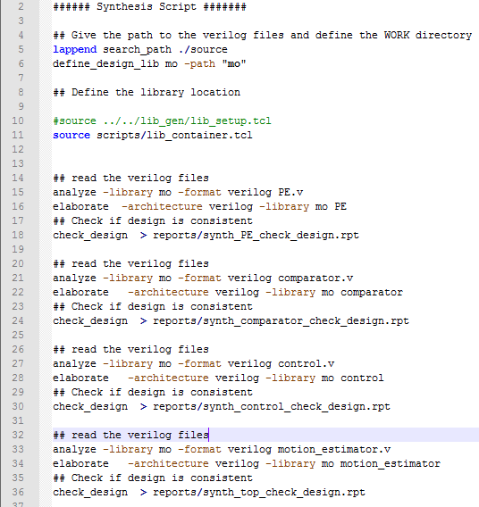
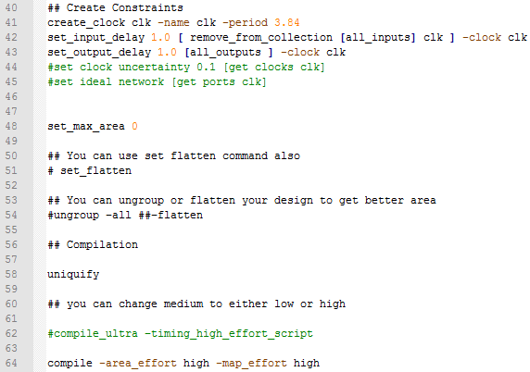
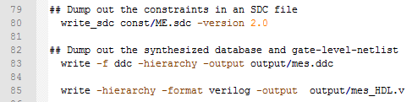
HDL Synthesis

Slide 10


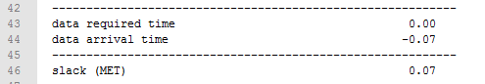
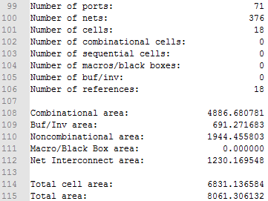

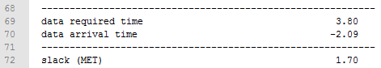

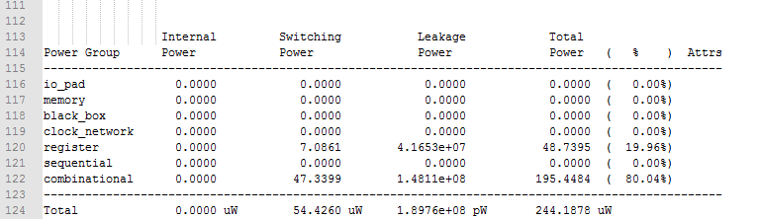
SYNTHESIS RESULTS

Slide 11
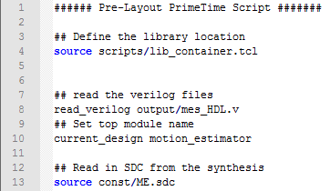
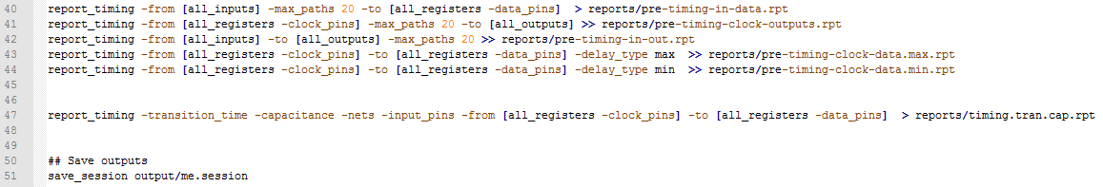
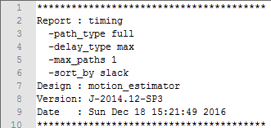
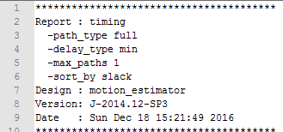
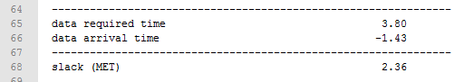
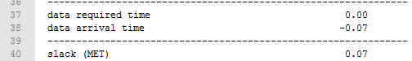
PRE-LAYOUT TIMING ANALYSIS

Slide 12
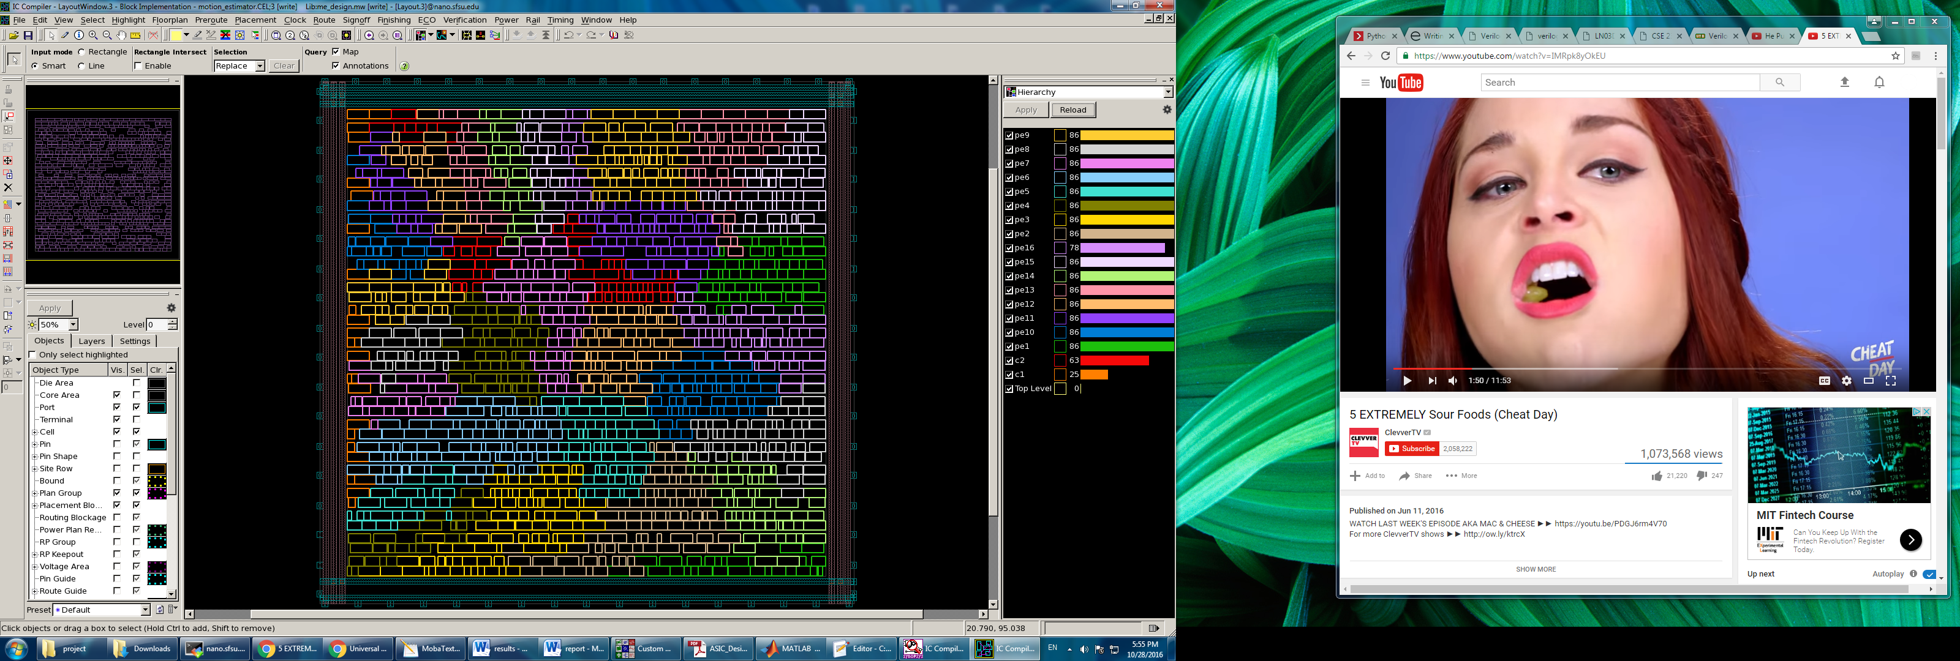
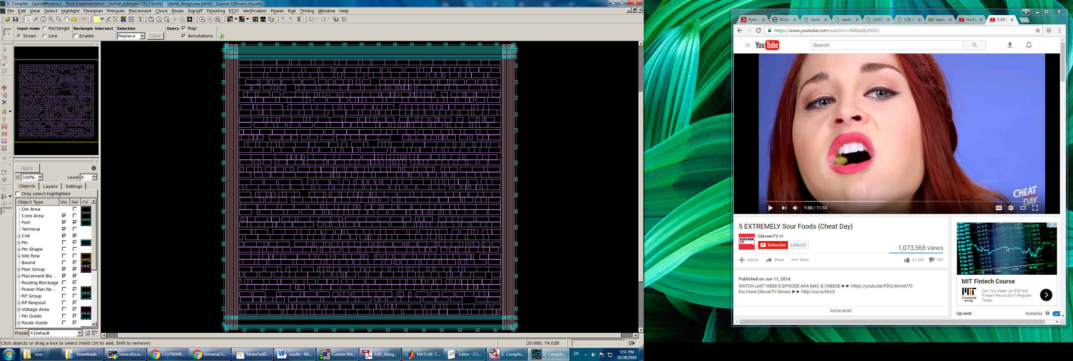
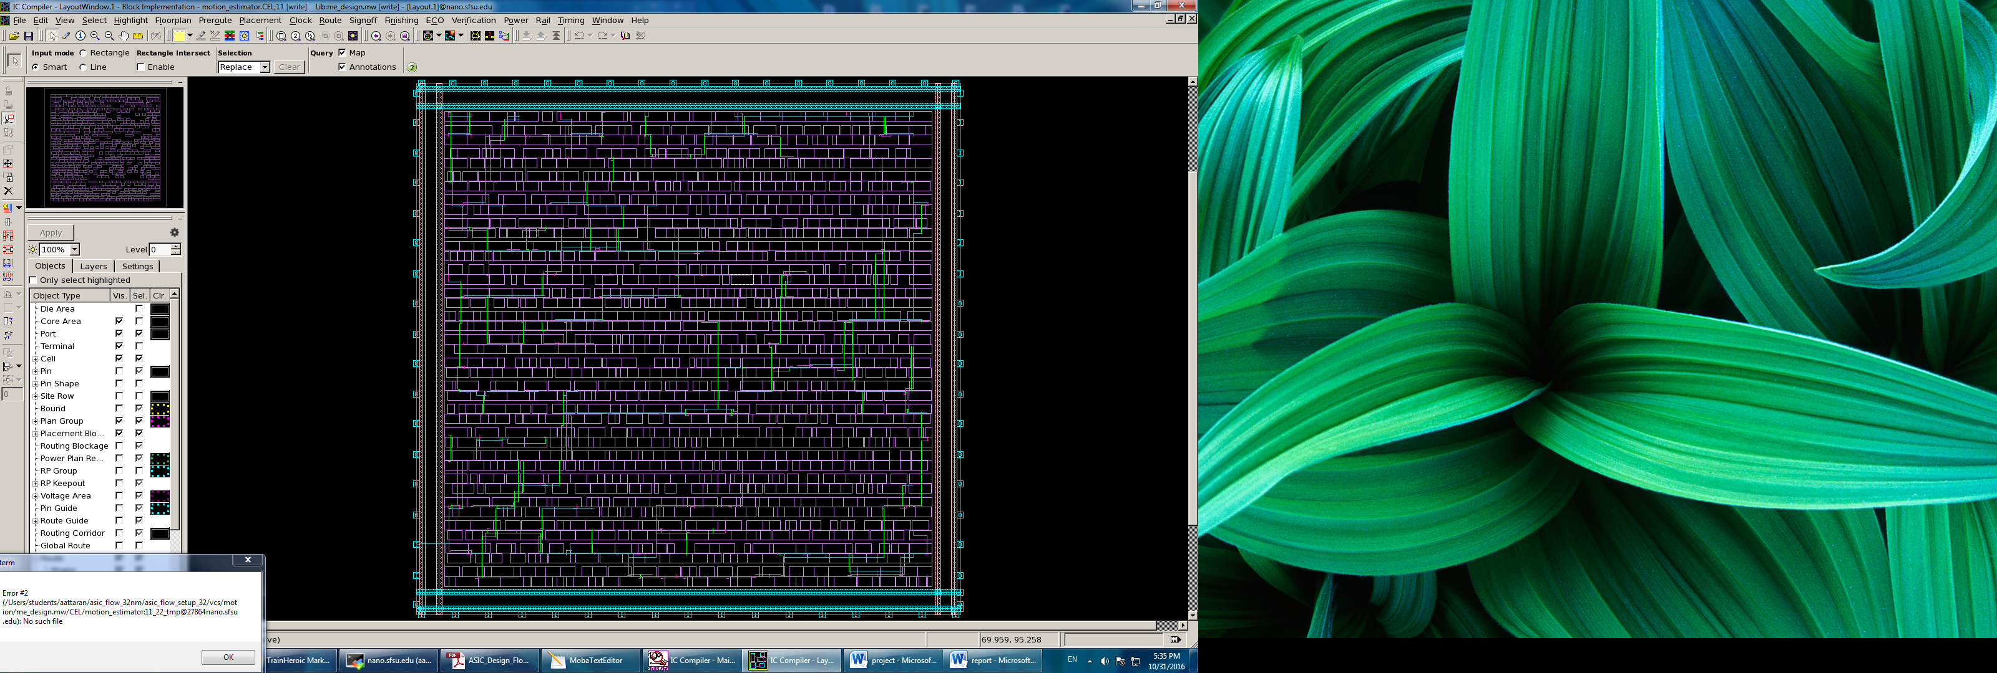
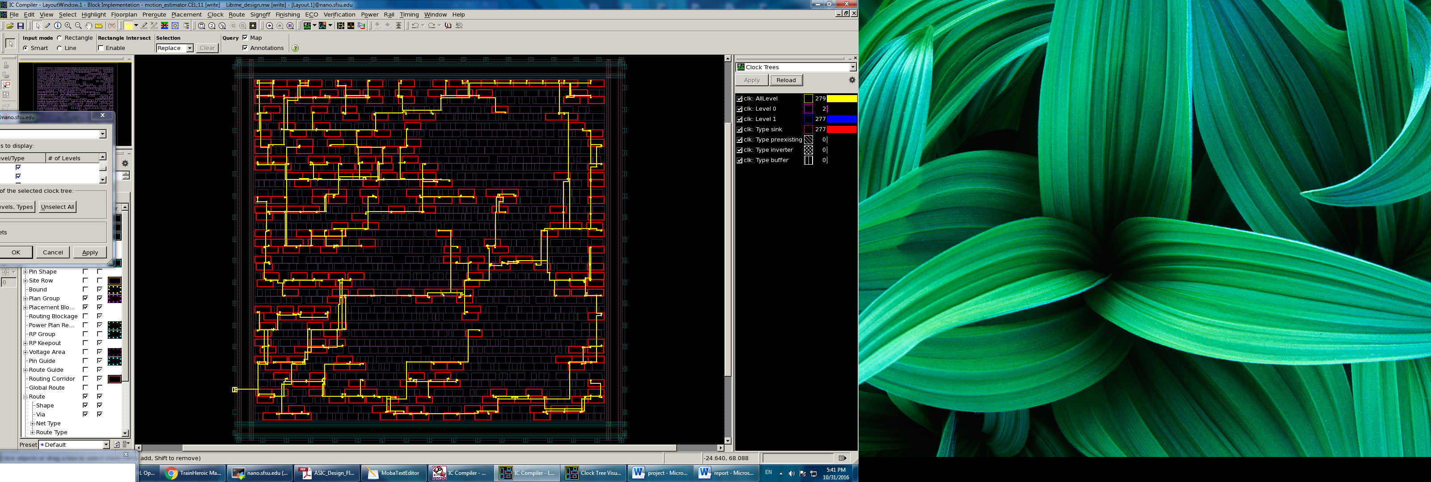

PHYSICAL IMPLEMENTATION
Pre-layout check in Primetime: checking slack, area, power
IC complier ->
Floor planning
Placing
Clock time synthesis (CTS)
Routing
Extract parasitics
Checking slack, area, power in Post-layout check in primetime

Slide 13
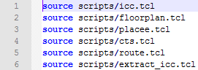
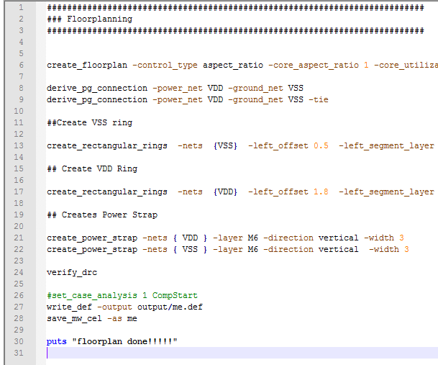
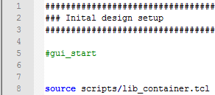
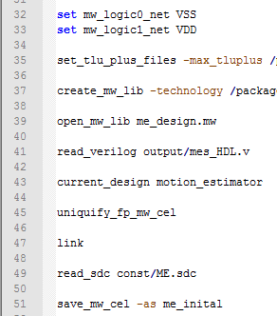
LAYOUT SCRIPTING

Slide 14
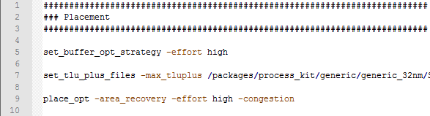
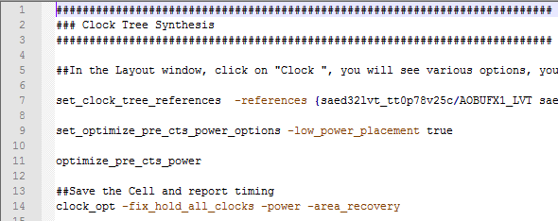
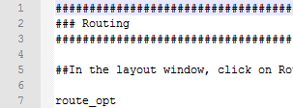
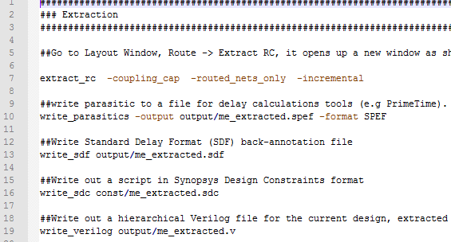
LAYOUT SCRIPTING

Slide 15
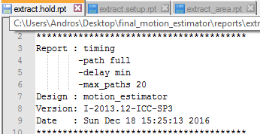
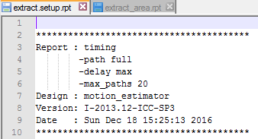
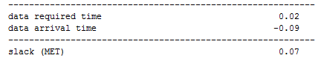
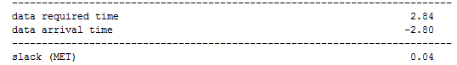
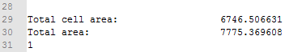
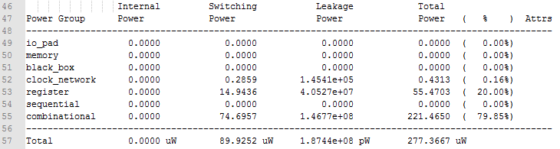
LAYOUT REPORTS

Slide 16
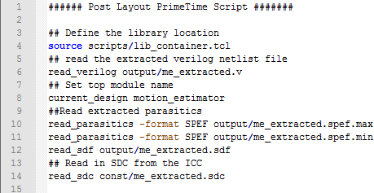
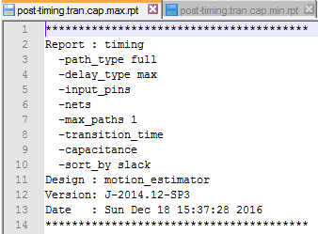
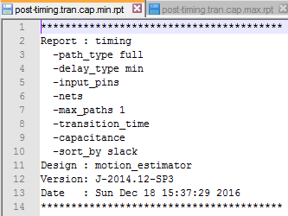
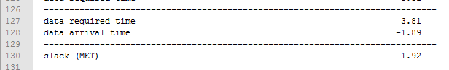
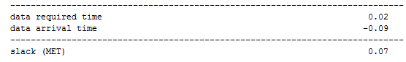
POST-LAYOUT TIMING ANALYSIS

Slide 17
DESIGN RESULTS
Period (nS) | Slacktime (nS) |  | Power (uW) | Area
3.7 | Hold time | Setup time | 277.4 | 7775.4
 | 0.07 | 1.92

Slide 18
REFERENCES
[1] Kim et al. A Fast VLSI Architecture for Full-Search Variable Block Size
Motion Estimation in MPEG-4 AVC/H.264
[2] Jun-Fu Shen, Tu-Chih Wang, and Liang-Gee Chen; A Novel Low-Power Full Search Block-Matching Motion-Estimation Design for H.263+
IEEE TRANSACTIONS ON CIRCUITS AND SYSTEMS FOR VIDEO TECHNOLOGY,
VOL. 11, NO. 7, JULY 2001
[3]www.fvc.com/FVC/FVCWEB/files/Static%20Macroblocks.070307.ppt
[4]Koziri et al. Novel Low-Power Motion Estimation Design for H.264
[5]Verilog Coding for Logic Synthesis, edited by Weng Fook Lee, John Wiley and Sons, Inc.
[6]CMOS Digital Integrated Circuits , Analysis and Design by Sung-Mo Kang & Yusuf Leblebici, TMH

